Slide 1
Task 2 – Seminar 4
Cyfra 21-1 as a biomarker of non-small cell lung cancer

Slide 2
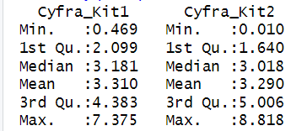
We start by exploring the data set. Which includes two different measurement kits.

Slide 3
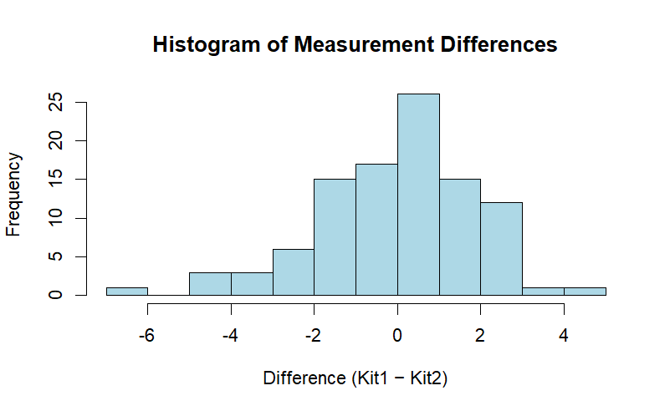
Normality check
We compute the differences for each measurement and visualize it using different plots. We continue with estimating the normality of the difference.

Slide 4
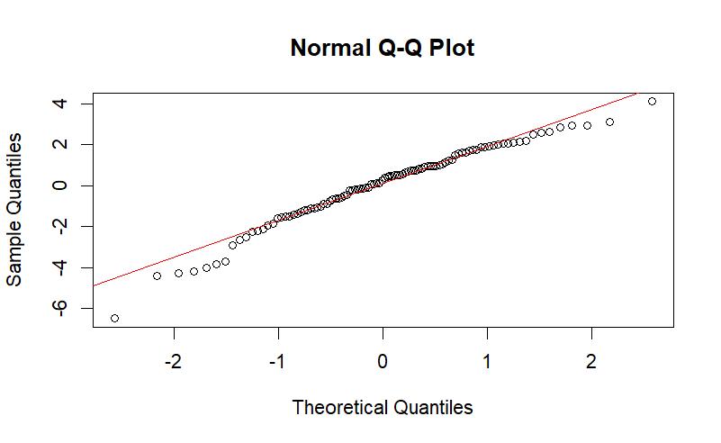
Normality check

Slide 5
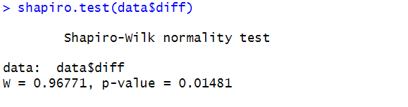
Normality check
According to the normality test we should reject the hypothesis that the difference is normal. However, according to both the histogram and the qq plot we still assume normality. Since approximate normality is something that the bland-altman assumes and not perfect.

Slide 6
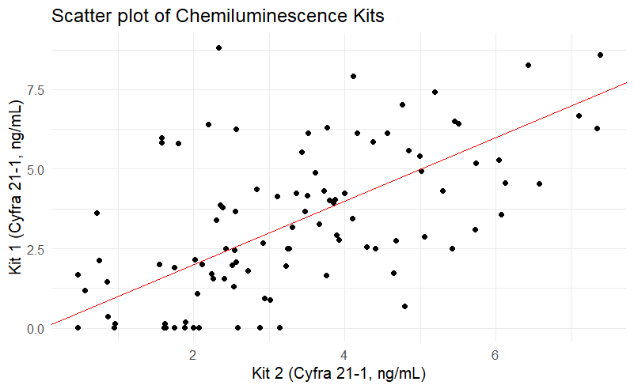
Explore methods for analysing the agreement and compare these.

Slide 7
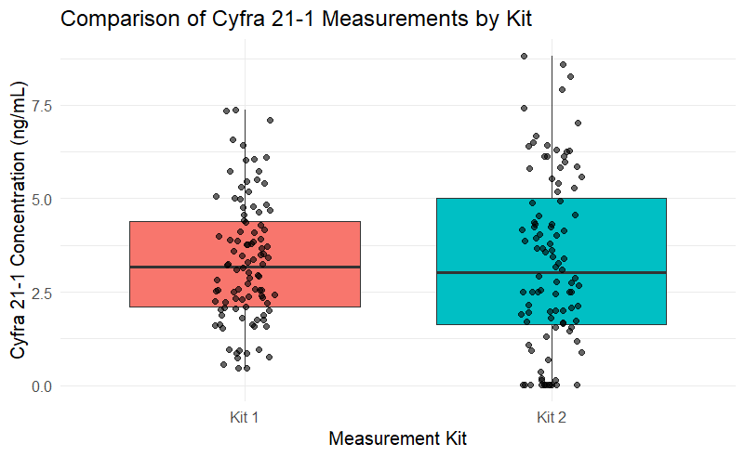

Slide 8
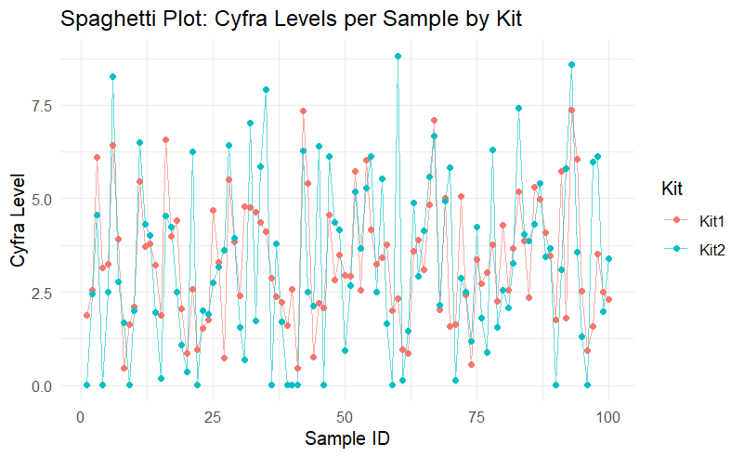
Notes:
A spaghetti plot of individual samples measured by both kits shows that Kit 2 consistently produces either systematically higher or lower values for each sample, suggesting a difference in spread

Slide 9
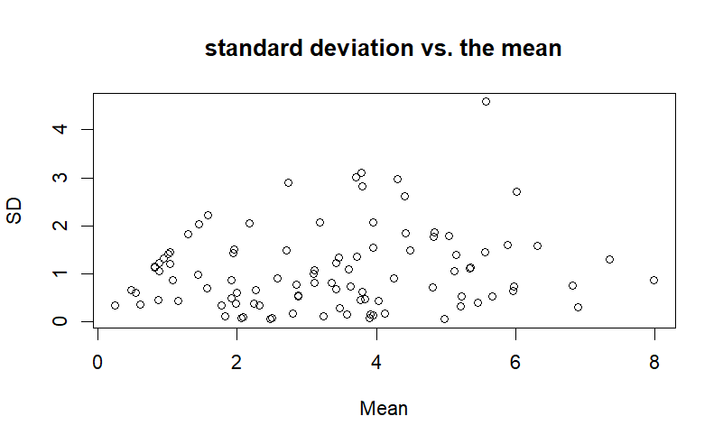
Notes:
Plotting the standard deviation vs. the mean reveals no strong evidence of proportional heteroscedasticity, but we observe slightly wider variability at higher concentrations.
This hints that a regression-based agreement model may be more appropriate.

Slide 10
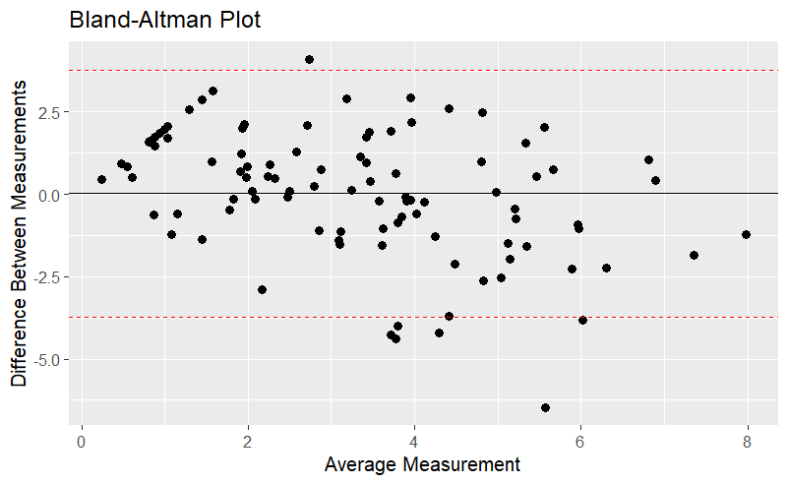
Notes:
The standard BA plot shows a downward trend in differences across the concentration range. This indicates: Proportional bias and violation of the constant-difference assumption which motivates trying a regression-based method.
The Bland–Altman method evaluates agreement between two measurement techniques by examining three key aspects.
First, it quantifies the systematic bias, meaning the average difference between the two methods, which indicates whether one method consistently measures higher or lower than the other.
Second, it provides limits of agreement, a range within which 95% of individual differences lie; this reflects the random error and precision of the methods and determines whether they can be used interchangeably for individual patients.
Third, the Bland–Altman plot reveals proportional bias, showing whether the difference between methods changes with the magnitude of the measurement—something standard BA cannot correct, and which may indicate the need for regression-based Bland–Altman if a trend is present.

Slide 11
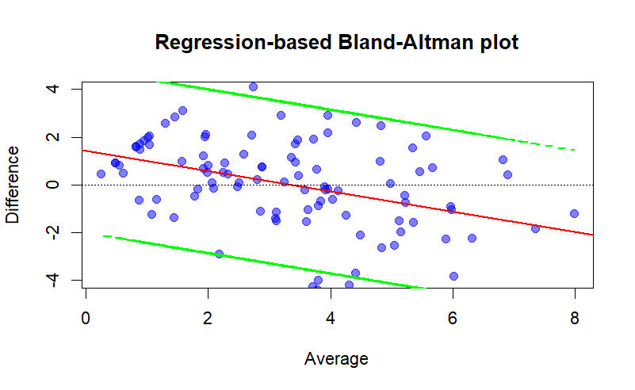
We try a regression-based Bland-Altman plot, we clearly see that this is more appropriate.

Slide 12
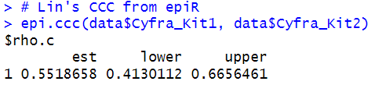
Lin´s CCC
0.5518 -> This value indicates poor to moderate agreement. CCC values closer to 1.0 indicate perfect agreement. The CL interval is far from 1.0, confirming the poor agreement is statistically significant

Slide 13
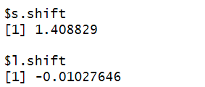
Lin´s CCC
1.41 -> relates to the ratio of the Standard Deviations of the two methods SD_Kit2 /SD_Kit1. A value >1 means Kit2 has a wider spread higher SD than Kit1.
-0.01 -> This relates to the difference between the means of the two methods Mean_Kit2 - Mean_Kti1. A small value means the means are very similar. Despite the near-zero mean difference, there is large random error and poor precision.

Slide 14
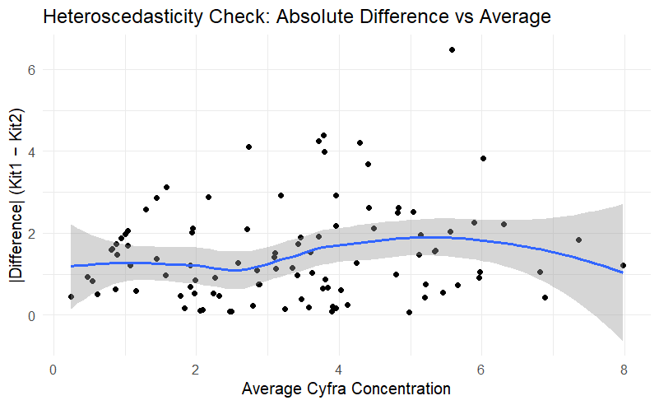
Plotting the difference against measurement magnitude
Larger differences at higher concentration
No major curvature, but visible proportional bias
Supports the regression-based BA method

Slide 15
Which method is most suitable given the data?
Given the observations:
Non-constant variability
Downward trend in the standard BA plot
Evidence of proportional bias
Larger variability in Kit 2
CCC confirming poor precision
The regression-based Bland–Altman method is the most appropriate for this dataset.
It properly accounts for:
Proportional bias
Heteroscedasticity
Non-constant limits of agreement
The classical Bland–Altman would misrepresent the agreement because it assumes constant variability.

